Slide 1
A-posteriori error estimates for finite element method
Babuška and W. C. Rheinboldt

Slide 2
Main results of the paper
Estimate for the error of the FEM solution
More accurate than simple residual
The user can be assured the necessary tolerance was achieved
The user can find optimal mesh size refining the grid until the tolerance is achieved
Local distribution of error shows where mesh refinement is needed (for non-regular grids)

Slide 3
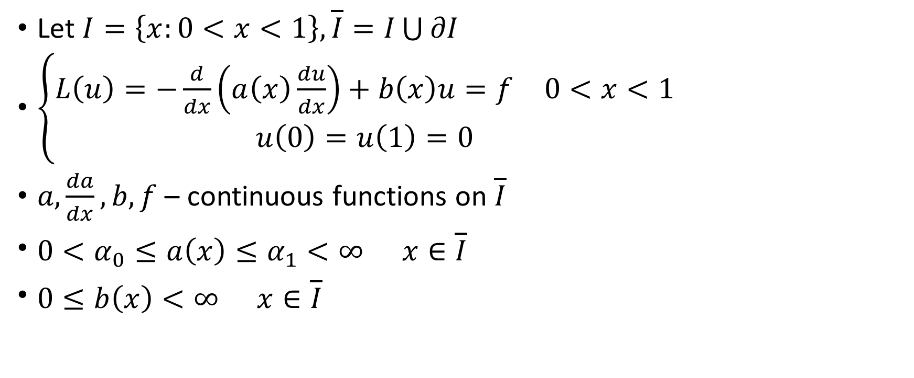
Problem statement and assumptions
Let $I=\left\{x:0<x<1\right\}, \overline{I}=I\bigcup{∂I}$
$\left\{\begin{aligned}\begin{matrix}L\left(u\right)=−\frac{d}{dx}\left(a\left(x\right)\frac{du}{dx}\right)+b\left(x\right)u=f & 0<x<1\end{matrix} \\ u\left(0\right)=u\left(1\right)=0\end{aligned}\right.$
$a,\frac{da}{dx},b,f$ – continuous functions on $\overline{I}$
$\begin{matrix}0<α_{0}≤a\left(x\right)≤α_{1}<∞ & x∈\overline{I}\end{matrix}$
$\begin{matrix}0≤b\left(x\right)<∞ & x∈\overline{I}\end{matrix}$

Slide 4
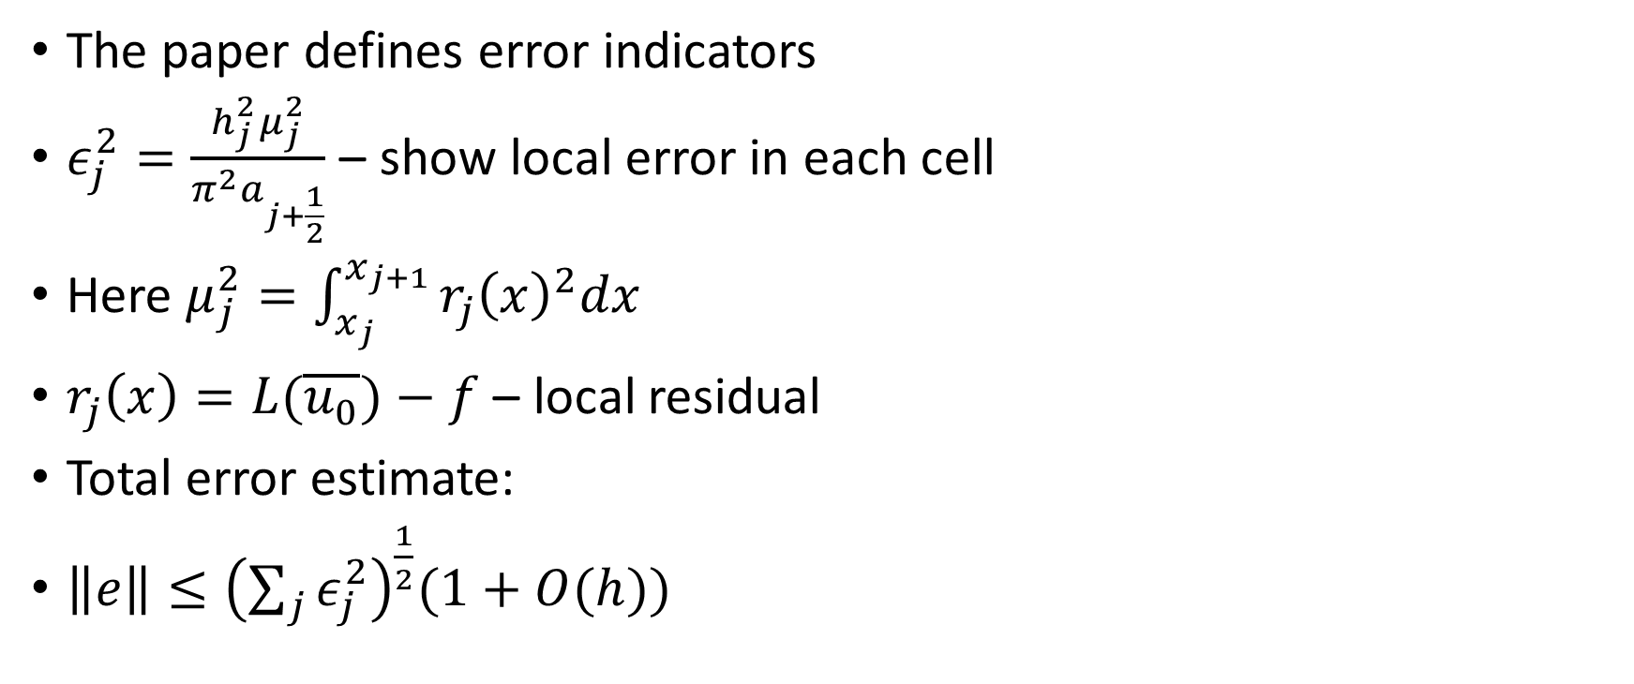
Brief summary
The paper defines error indicators
$ε_{j}^{2}=\frac{h_{j}^{2}μ_{j}^{2}}{π^{2}a_{j+\frac{1}{2}}}$ – show local error in each cell
Here $μ_{j}^{2}=\int_{x_{j}}^{x_{j+1}}{r_{j}{\left(x\right)}^{2}dx}$
$r_{j}\left(x\right)=L(\overline{u_{0}})−f$ – local residual
Total error estimate:
$\left\|e\right\|≤{\left(\sum_{j}{ε_{j}^{2}}\right)}^{\frac{1}{2}}(1+O(h))$

Slide 5
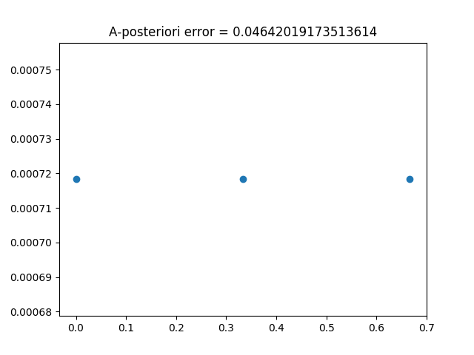
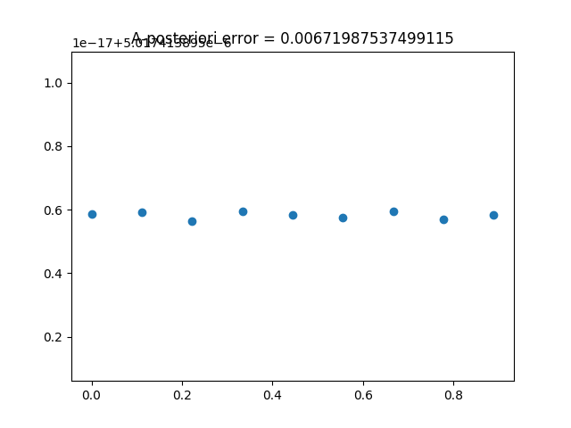
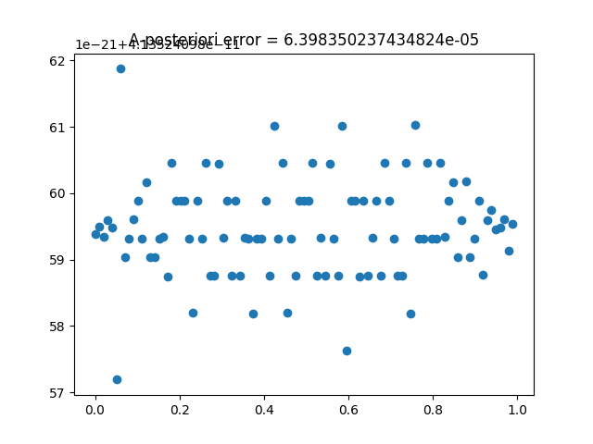
Example

